Slide 1
Wide and Deep Learning for Recommendation Systems
CS795/895 Big Data and Recommender Systems
Raja Harsha Chinta

Slide 2
Abstract
Generalized linear models with nonlinear feature transformations are widely used for large-scale regression and classification problems with sparse inputs.

Slide 3
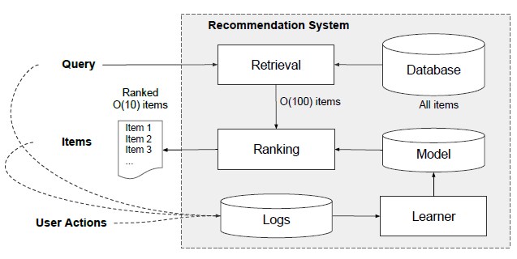
Recommender Systems Overview

Slide 4
Generalization & Memorization
Generalization
Generalizing the statements and applying them for events not seen.
“Sparrows can fly.”
“Pigeons can fly.”
→ “Animals with wings can fly.”
Memorization
Memorization further refine our Generalization rules with exceptions.
→ “Penguins can’t fly.”
Jointly training a wide linear model (for Memorization) alongside Deep Neural Network (for Generalization) can combine strengths of these two.

Slide 5
Wide & Deep Learning
Wide & Deep Learning combines the power of Memorization and Generalization by joining Wide Linear Models and Deep Neural Networks.
Google has released and Tflearn API on top of TensorFlow to use this model.
Good for generic large scale Regression and Classification problems with Sparse inputs like Recommender Systems, Search and Ranking Problems.

Slide 6
Recommendation Problem
Open a new app FoodIO: Say what food you are craving for (the query).
The app match characters and assumes the user may like the best match dish, delivers at your door (the item).
If user likes the ordered food the score is 1 otherwise it is 0 (the label).
User orders are reduced as the matches are in-accurate, so we bring Machine Learning to predict and order the food the user may like more.
Example Scenario:
The query = ‘fried chicken’ → The item = ‘chicken fried rice’
The label = 0

Slide 7


The Wide Component
Memorize what items work the best for each query and it is generalized linear model of form below:
y is the prediction
X = [x1, x2, ……, xd] is a vector of d features
W = [w1, w2,....., wd] are model parameters
b is bias
Capture interactions between binary features, adds nonlinearity to generalized model.
Train a linear model in TensorFlow with a wide set of cross-product feature transformations to capture how the co-occurrence of a query-item feature pair correlates with the target label (here 1/0).

Slide 8
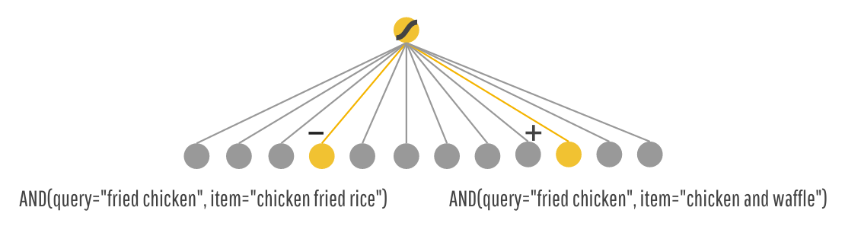


Wide Component Example
For example, the model learns that feature and predicts:
AND(query="fried chicken", item="chicken and waffles") is Liked by User,
AND(query="fried chicken", item="chicken fried rice") is Not Liked by User even though the character match is higher.

Slide 9

The Deep Component
Is a feed-forward neural network.
For categorical features, the original inputs are feature strings (e.g., “language=en”). Each of these sparse, high-dimensional categorical features are first converted into a low-dimensional and dense real-valued vector, embedding vector.
The embedding vectors are initialized randomly and then the values are trained to minimize the final loss function during model training.
These low-dimensional dense embedding vectors are then fed into the hidden layers of a neural network in the forward pass.
l is the layer number and Activation Function f used here is ReLU.

Slide 10
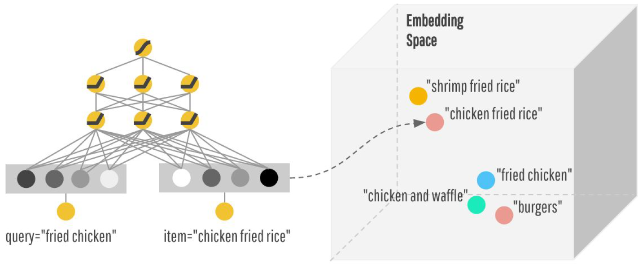
Deep Component Example
Now, users asks for similar, but different food.
Similar food are close in the Embedding Space.

Slide 11
Joint Training of Wide & Deep Model
The wide component and deep component are combined using a weighted sum of their output log odds as the prediction, which is then fed to a common logistic loss function for joint training.
Joint training optimizes all parameters simultaneously by taking both the wide and deep part as well as the weights of their sum into account at training time.
Joint training of a Wide & Deep Model is done by back-propagating the gradients from the output to both the wide and deep part of the model simultaneously using mini-batch stochastic optimization.
L1 regularization is used for wide part and AdaGrad for deep part and FLTR (Follow-the-Regularization-Leader) optimizer.

Slide 12
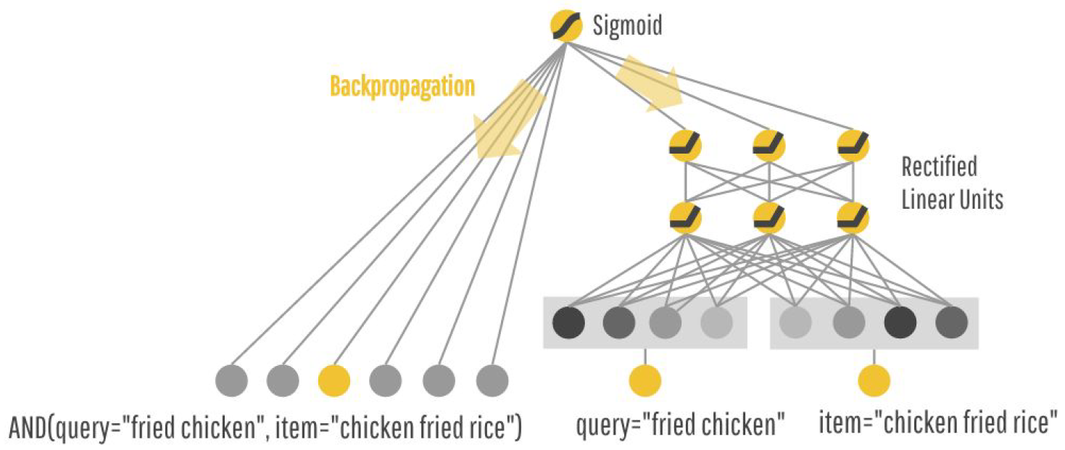
Wide & Deep Model

Slide 13
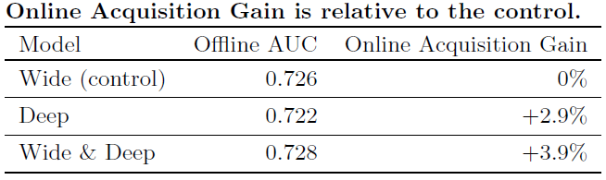
Real-World Results
Google’s App recommender servers score over 10 million apps per second.
With single threading, scoring all candidates in a single batch: 31 ms
With multithreading and split each batch into smaller sizes: 14 ms

Slide 14
References
https://engineering.linkedin.com/data/publications/kdd-2017/deep-learning-tutorial
https://github.com/amygdala/tensorflow-workshop/tree/master/workshop_sections/wide_n_deep
https://research.googleblog.com/2016/06/wide-deep-learning-better-together-with.html

Slide 15
Thank you
Please write your queries to rchin001@odu.edu

